Slide 1


Multimodal Ticket Severity Classification System
A Deep Learning Approach for Automated Customer Support Ticket Prioritization
Group No. 6

Slide 2



Problem Statement & Real-world Challenges
Customer support systems rely heavily on manual ticket classification, which leads to :-
Manual Triage Time
Annual Cost per Team
Critical Issue Delay
Human Error Rate
Our AI Solution:-
Automated classification in few sec
reduction in triage time
Real-time severity assessment
improvement in customer satisfaction

Slide 3


Objectives
To develop a multimodal deep learning system that accurately classifies customer support ticket severity by jointly analyzing error screenshots and textual descriptions, enabling faster and more reliable incident prioritization.
To automatically classify customer support tickets by severity
To utilize both image screenshots and text descriptions
To improve accuracy using multimodal fusion learning
To deploy a user-friendly web-based interface

Slide 4

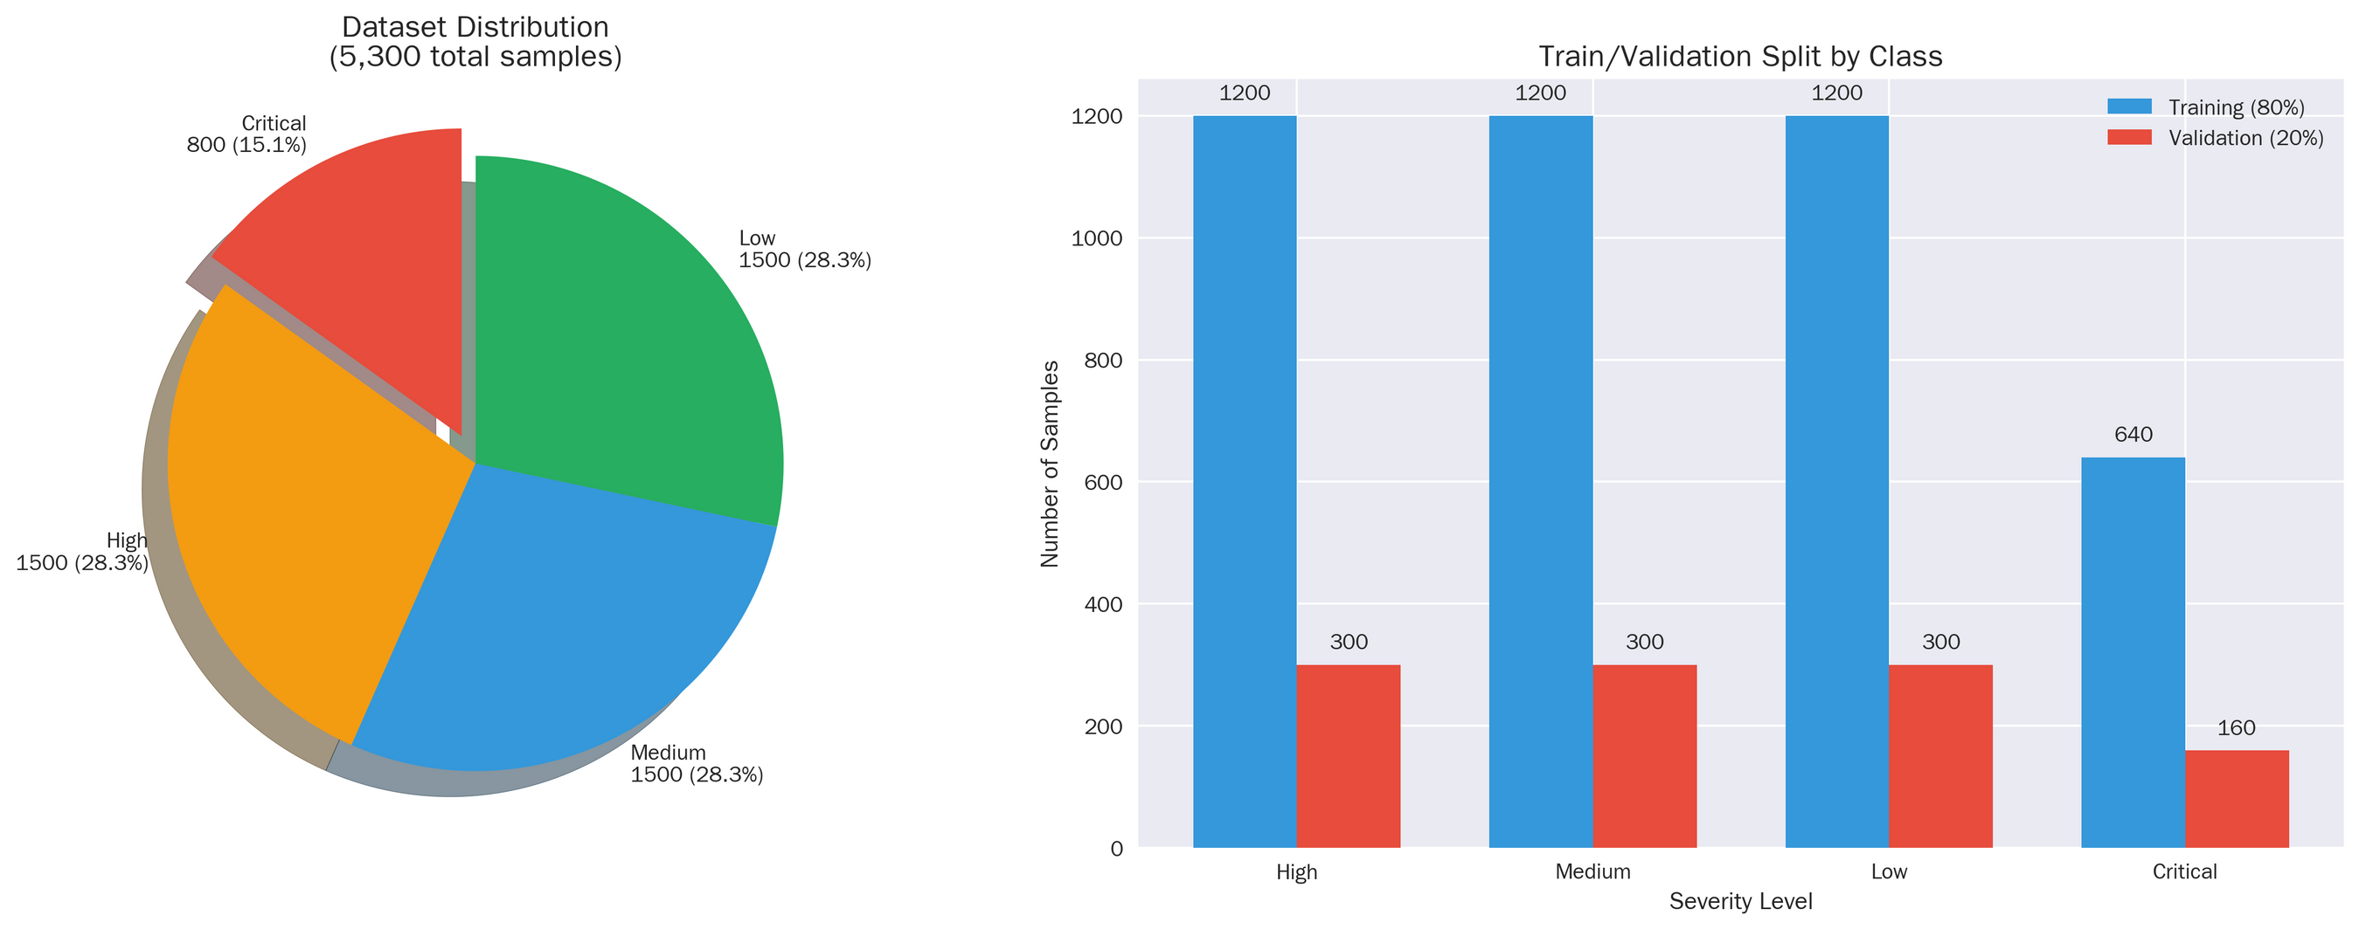
The Data

Slide 5
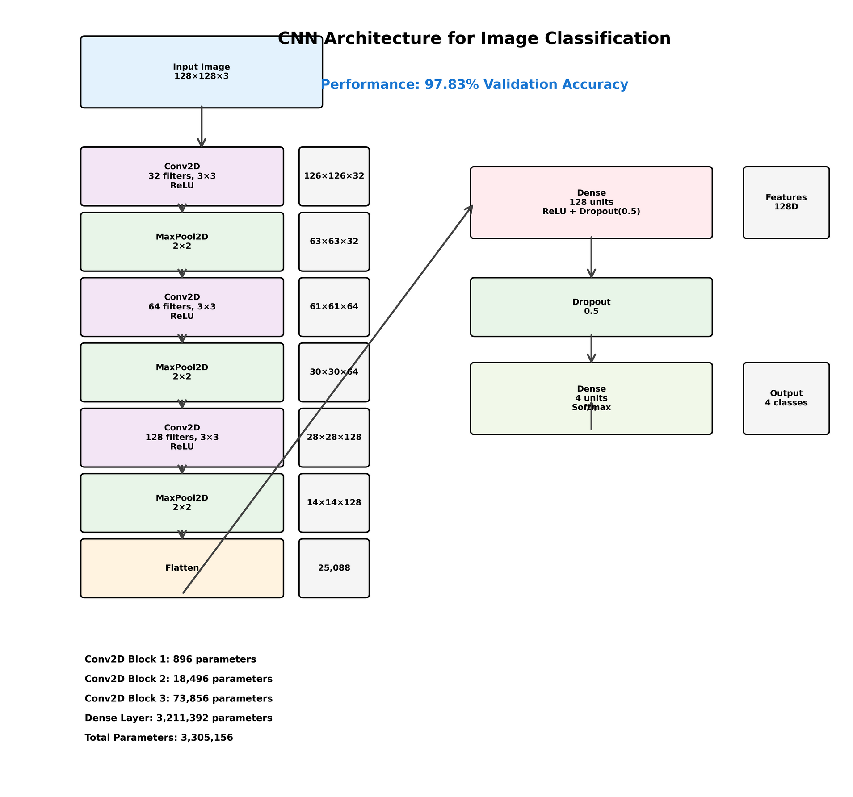
CNN Architecture

Slide 6


01
CNN Image Pipeline
Total Parameters: 3,305,156 (12.61 MB) Trainable Parameters: 3,305,156 Non-trainable Parameters: 0 Model Size: 12.61 MB
97.83%
Validation Accuracy
3.3M
Total Parameters
Training Insights: Gradual convergence with rapid improvement in epochs 5-8, achieving excellent generalization with minimal overfitting
8
Training Epochs
0.98
F1-Score

Slide 7

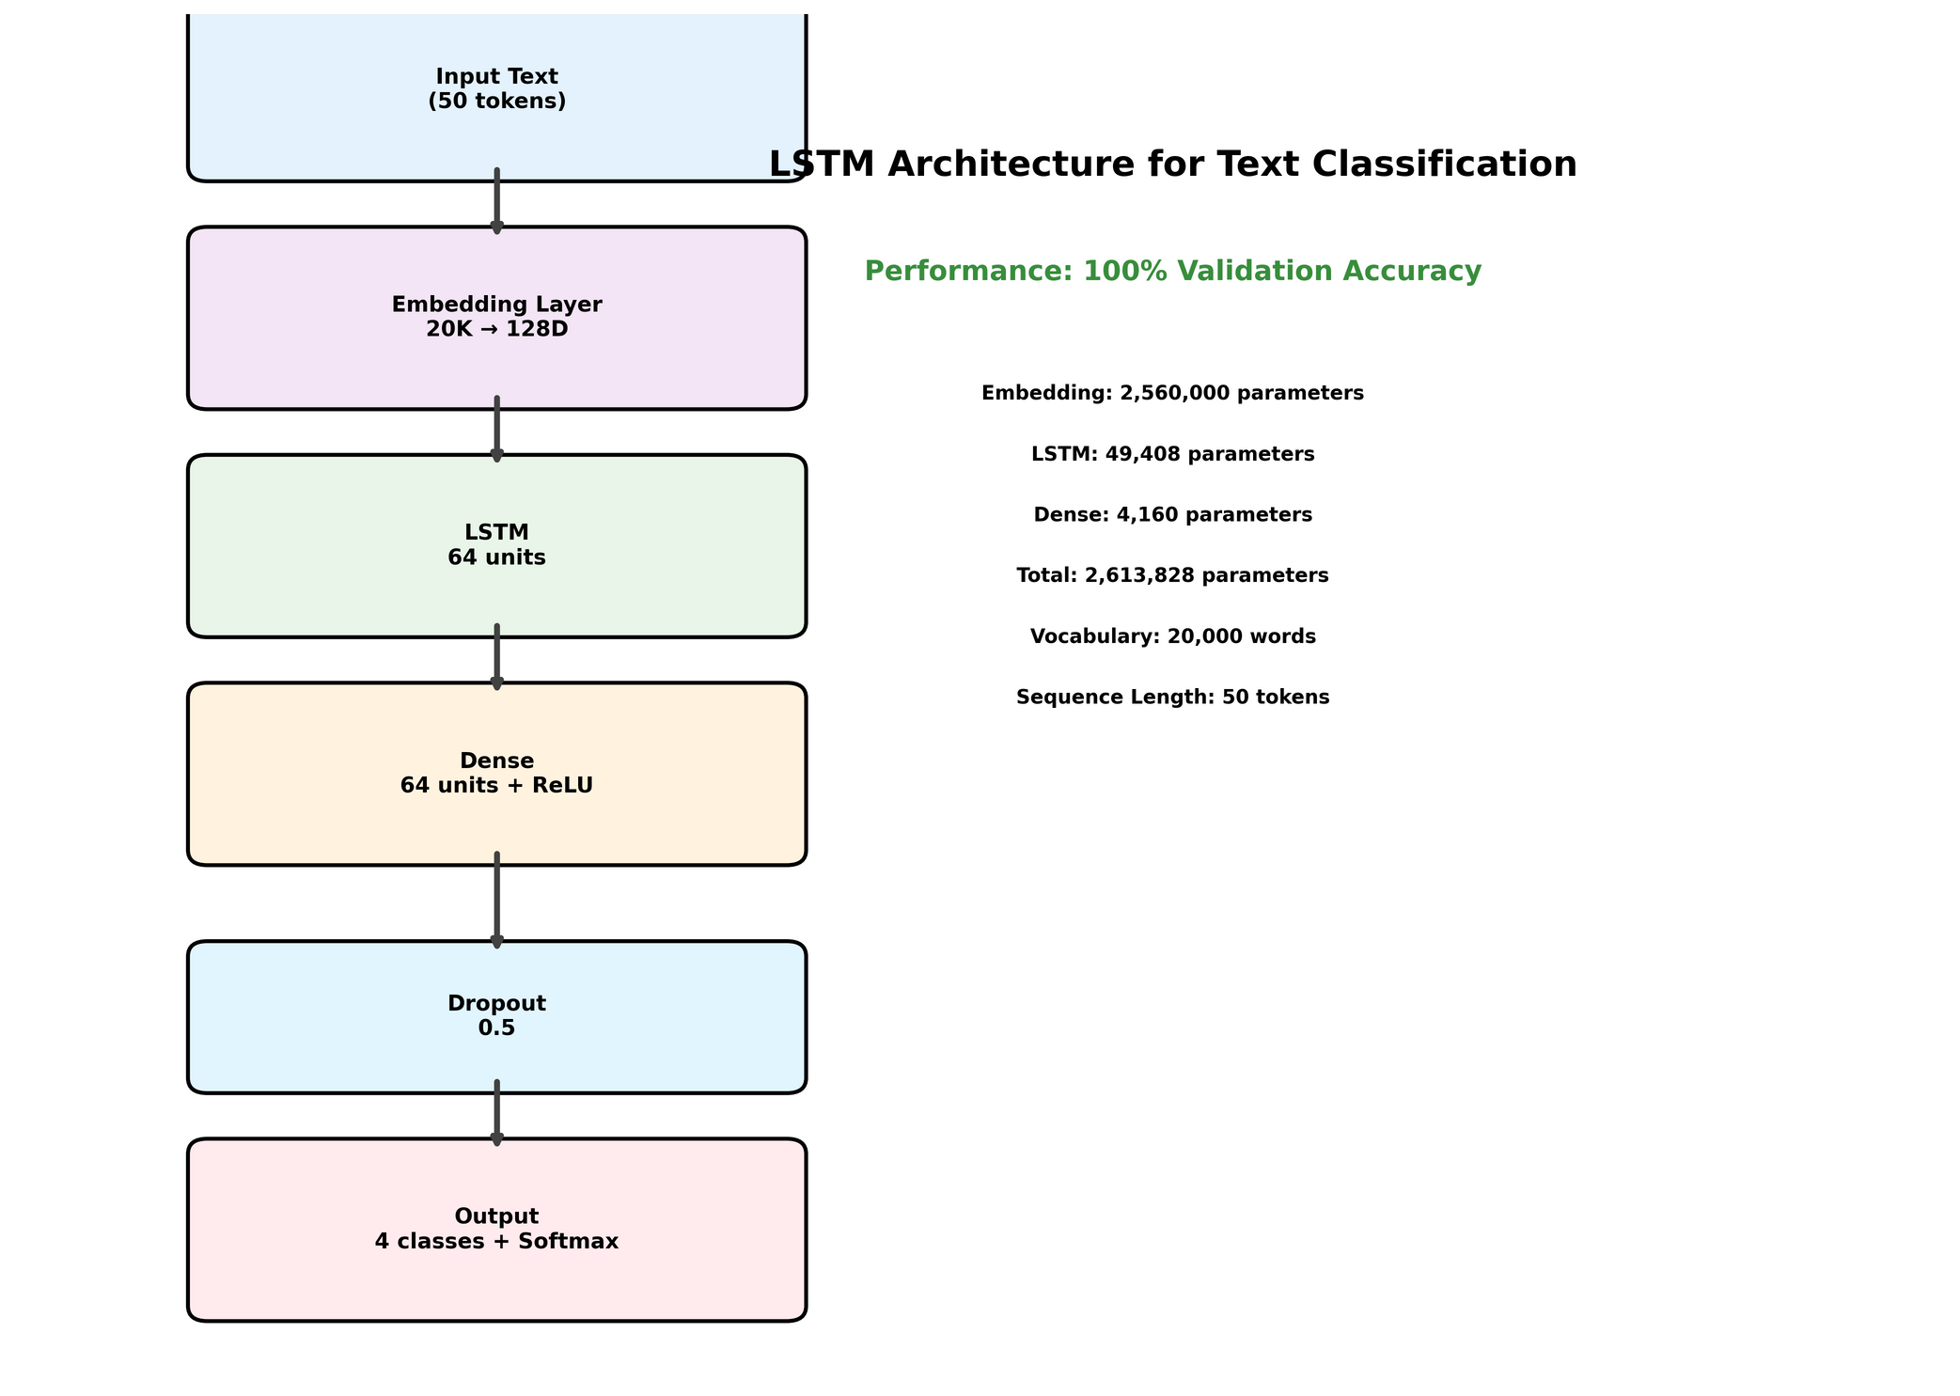
LSTM Architecture

Slide 8



02
NLP LSTM Text Processing Pipeline
Total Parameters: 2,613,828 (9.97 MB) Embedding Parameters: 2,560,000 LSTM Parameters: 49,408 Dense Layer Parameters: 4,420
100%
Accuracy
2.6M
Parameters
5
Training Epochs
0.3s
Inference Time

Slide 9
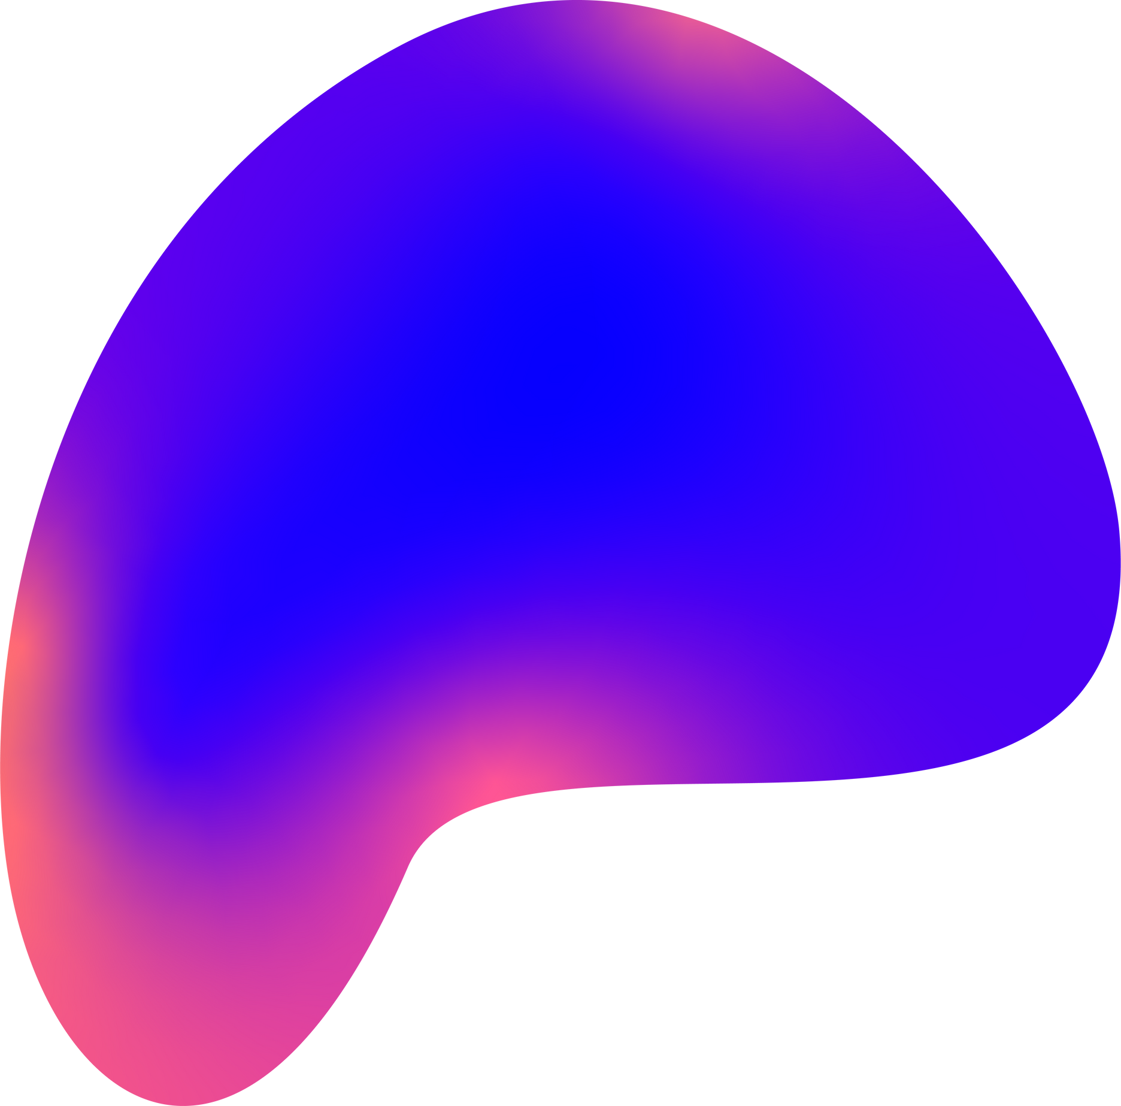
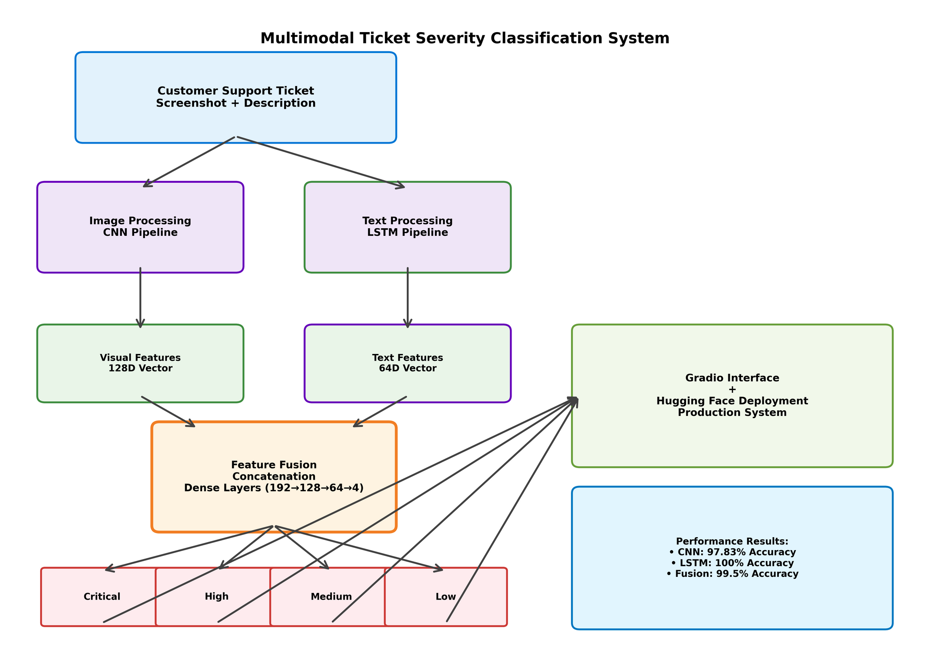
Multimodal
Architecture
Overview

Slide 10
03
Multimodal Fusion Model Architecture
Total Parameters: 5,951,428 (22.70 MB) Trainable Parameters: 33,220 (0.56%) Non-trainable Parameters: 5,918,208 (99.44%) Image Feature Dimensions: 128 Text Feature Dimensions: 64 Combined Feature Dimensions: 192
99.5%
Fusion Accuracy
33K
Trainable Parameters
Best of Both Worlds: Fusion model achieves optimal balance between visual pattern recognition and textual context understanding
1.2s
Response Time
6
Training Epochs

Slide 11
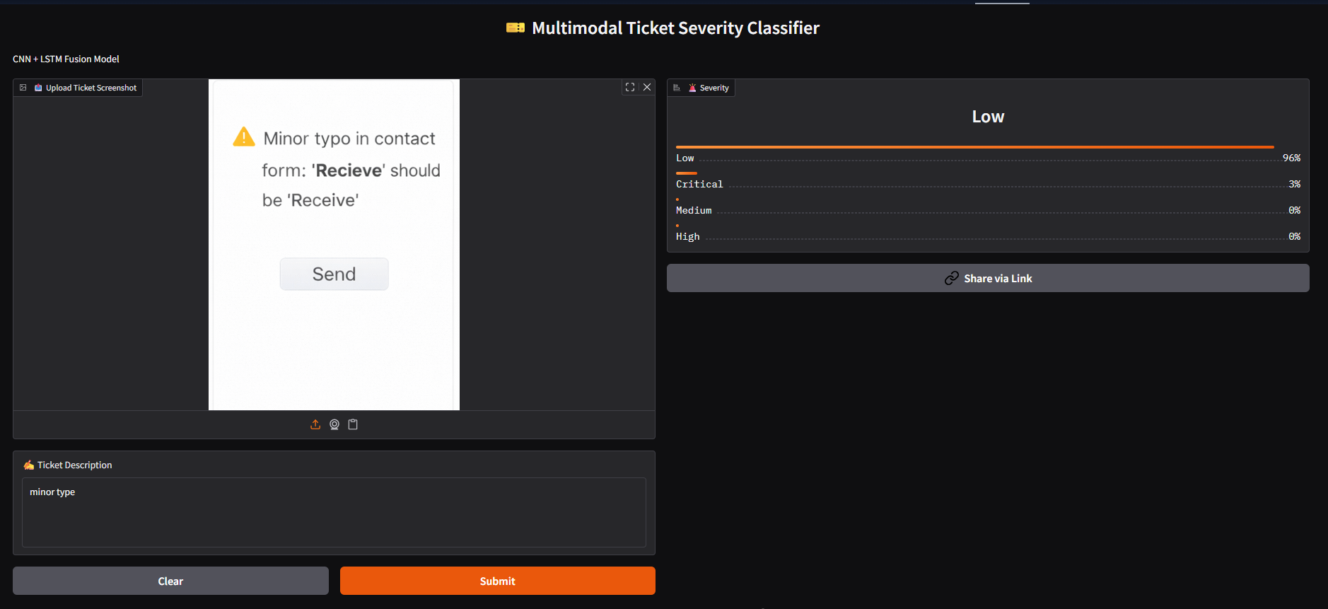
OUTPUT:-
Multimodal
Architecture
Overview

Slide 12
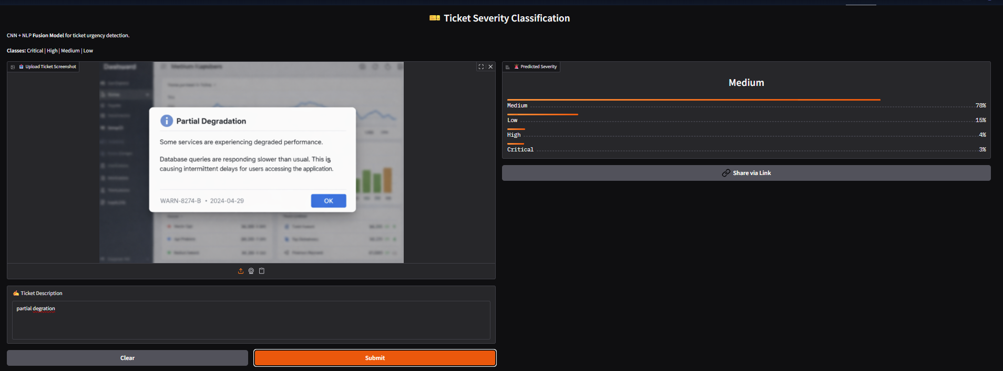
Multimodal
Architecture
Overview

Slide 13
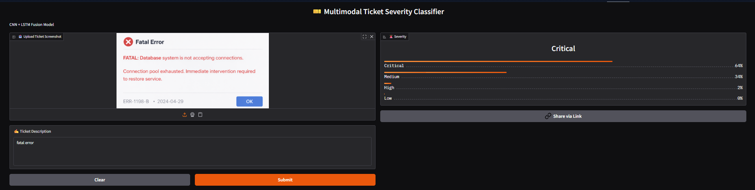
Multimodal
Architecture
Overview

Slide 14
Conclusion and future scope:-
Technical Achievements
Business Impact
Innovation Highlights
Future Potential
First multimodal ticket classifier
2. Advanced fusion architecture
3. Intelligent post-processing system
4. Real-time deployment capabilities
5. Cross-industry applicability
Multi-language expansion ready
2. Edge deployment capabilities
3. Explainable AI integration
4. Federated learning support
5. Foundation model evolution
Significant cost reduction ($180K/year)
2. customer satisfaction (+40%)
3. Enhanced support efficiency (285%)
4. Competitive advantage in automation
multimodal fusion architecture
2. Robust CNN + LSTM combination
3. Production-ready deployment with Gradio

Slide 15


Thank You

